Slide 1
Build a Strong MERN Foundation
Notes:
Trainer Notes:
This slide is self-explanatory, trainer notes not required.

Slide 2
Customize an Application Using Bootstrap

Slide 3
A Day in the Life of a MERN Stack Developer
Joe has gained expertise in Bootstrap. A new project for a food industry is assigned to him.
He must develop a customizable website for a restaurant which will
provide a brief information of the restaurant, its bestsellers, and the contact number of the restaurant.
In this lesson, you will learn how to solve this real-world scenario to help Joe complete his task effectively and quickly.

Slide 4

Distinguish between HTML, CSS, Bootstrap typography, and utilities
Illustrate the Bootstrap design
Develop buttons, navigation bars, and input groups
Implement carousel, accordion, modal, and pagination
Create forms, tabs, and captions

Slide 5
Introduction to Bootstrap

Slide 6

What Is Bootstrap?
Bootstrap is an HTML, CSS, and JavaScript framework for creating a mobile-friendly and responsive website.
Notes:
Explain about Bootstrap: Bootstrap is an HTML, CSS, and JavaScript framework for creating a mobile-friendly and responsive website.
It includes design templates for typography, forms, buttons, navigation, and other interface components in HTML, CSS, and JavaScript.

Slide 7

Features of Bootstrap
It is easy to use.
It is mobile-friendly.
It is compatible with any browser.
It provides powerful grid systems.
It provides bundled JavaScript plugins.
It uses the mobile-first approach.
It can be easily integrated.
Notes:
List the features of Bootstrap:
It is easy to use.
It is mobile-friendly.
It is compatible with any browser.
It provides powerful grid systems.
It provides bundled JavaScript plugins.
It uses the mobile-first approach.
It can be easily integrated.

Slide 8


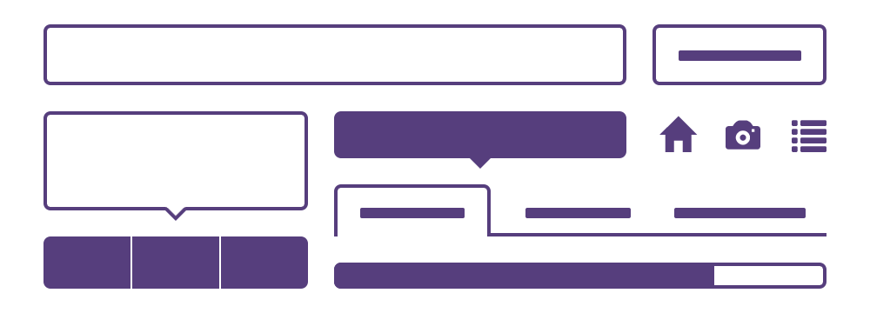
Properties of Bootstrap
Preprocessors
One framework for every device
Customizable
Notes:
List the properties of Bootstrap: Self-explanatory

Slide 9
Properties of Bootstrap
The Bootstrap source code makes use of the two most popular CSS preprocessors, Less and Sass.
Preprocessors
Notes:
Self-explanatory

Slide 10
Properties of Bootstrap
Bootstrap scales the websites and applications from phones to tablets to desktops with a single code base.
One framework for every device
Notes:
Self-explanatory

Slide 11
Properties of Bootstrap
Bootstrap provides extensive and visually appealing documentation for HTML elements, custom HTML and CSS components, and jQuery plugins.
Customizable
Notes:
Self-explanatory

Slide 12


Competitors
These are a few front-end web designing alternatives that can be used instead of Bootstrap:
Foundation
Notes:
While Foundation focuses on the visual and customizability aspects of a project, Bootstrap focuses on functionality rather than the appearance of the final project.
Skeleton is a small CSS file collection that can help you quickly create sites that look great at any size, whether it's a 17" laptop screen or an iPhone.

Slide 13
Responsive Web Design: Introduction
Responsive web design is a responsive browser that can adapt to different screen sizes.
Notes:
The goal of responsive web design is to create web pages that look good on all devices A responsive web design will adapt to different screen sizes and viewports automatically.

Slide 14
Responsive vs. Adaptive
It is a fluid design that responds to the browser and can resize to fit the screen without leaving any empty space.
Responsive
Adaptive
An adaptive design adjusts to the screen size only at specific points.
Responsive web design
Notes:
Compare responsive and adaptive web design:
It is a fluid design that responds to the browser and can resize to fit the screen without leaving any empty space.
An adaptive design adjusts to the screen size only at specific points.

Slide 15
Relative vs. Static Units
Relative units can adapt to any screen in percentages, unlike static units that render in fixed pixel size.
100%
600px
50%
50%
300px
300px
Relative units
Static units
Notes:
Compare relative and static units:
Static units are defined by a fixed length value. The value will not change regardless of whether the screen's width or height changes.
In contrast to absolute units, relative units are not fixed. Their values are "relative" to one another. This means that if the other value changes, so will the relative unit value.

Slide 16
Flow vs. Static
The flow in a responsive web design helps the content to smoothly adjust when the screen size changes, unlike in static web design.
Flow
Static
Notes:
Self-explanatory

Slide 17
With vs. Without Breakpoints
When the screen size changes, the presence of breakpoints allows the content to adapt to the screen size.
With Breakpoints
Without Breakpoints
Notes:
In Bootstrap, breakpoints are customizable widths that determine how your responsive layout behaves across device or viewport sizes.

Slide 18
Vectors vs. Images
A vector adapts to the resolution of the retina and its quality is independent of the screen resolution. In case of image, it cannot adapt the resolution of retina.
Vector
Image
Notes:
Self-explanatory

Slide 19

Mobile-First
To develop a mobile-first design:
Start with CSS development for mobile devices, followed by media queries to adapt to desktops and tablets
Determine the content that is the most important
Notes:
Start with CSS development for mobile devices, followed by media queries to adapt to desktops and tablets
Determine the content that is the most important
A "mobile-first" approach entails creating a desktop site first with a mobile version that is then adapted to larger screens.

Slide 20

Why Mobile-First?
It is a design that prioritizes the user experience on smaller screens and slower internet connections.
The application is accessible and usable on a wide range of devices.
It can also lead to a more streamlined and efficient design overall.
Millions of
mobile users worldwide
Notes:
Explain the reasons to use mobile-first design:
It is a design that is independent of the screen size.
It helps avoid overwriting of code.
It narrows down the website information to a convenient portion.

Slide 21
Creating First Page with Bootstrap: Step 1
Example:
At the start of the page, include HTML5 doctype and the lang attribute with the right character set.
Add the viewport <meta> tag for proper touch zooming and rendering.
Adjust the width and the initial zoom level of the page as per the device.
<!DOCTYPE html>
<html lang=“pt”>
<head>
<meta charset=“utf-8”>
<meta name=“viewport” content=“width=device-width, initial-scale=1”>
</head>
</html>
Notes:
At the start of the page, include HTML5 doctype and the lang attribute with the right character set.
Add the viewport <meta> tag for proper touch zooming and rendering.
Adjust the width and the initial zoom level of the page as per the device.

Slide 22
Creating First Page with Bootstrap: Step 2
Include the following files:
bootstrap.min.css
bootstrap.min.js
Example:
<link rel="stylesheet" href="https://cdn.jsdelivr.net/npm/bootstrap@4.3.1/dist/css/bootstrap.min.css" integrity="sha384-ggOyR0iXCbMQv3Xipma34MD+dH/1fQ784/j6cY/iJTQUOhcWr7x9JvoRxT2MZw1T" crossorigin="anonymous">
<script src="https://cdn.jsdelivr.net/npm/bootstrap@4.3.1/dist/js/bootstrap.min.js" integrity="sha384-JjSmVgyd0p3pXB1rRibZUAYoIIy6OrQ6VrjIEaFf/nJGzIxFDsf4x0xIM+B07jRM" crossorigin="anonymous"></script>
Notes:
bootstrap.min.css has been minified. This means that all whitespace and other extra characters have been removed. This is commonly done in production to reduce file size.
min. js is simply a compressed version of jquery. js. You can use it in the same way as jquery. js, but it's smaller, so use the minified version in production and normal jquery when debugging.
Only include min. js if you intend to use components that require the file.

Slide 23
Creating First Page with Bootstrap: Step 3
A user can include container classes in Bootstrap to wrap the site's contents.
Example:
<div class=“container”>
<h1>My First Bootstrap Page</h1>
<p>this is some text.</p>
</div>
<div class=“container-fluid”>
<h1>My First Bootstrap Page</h1>
<p>This is some text.</p>
</div>
Notes:
Self-explanatory

Slide 24
Import Bootstrap in Your Application
Duration: 20 Min.
Problem Statement:
You are given a project to create an HTML page and include Bootstrap to your web application.

Slide 25
Assisted Practice: Guidelines
Steps to be followed:
Write an HTML page in your code editor
Add Bootstrap to your application using CDN
Host Bootstrap locally

Slide 26
Browsers and Devices Compatibility

Slide 27
Supporting Mobile Devices
Bootstrap supports the latest versions of each major platform’s default browsers on mobile devices.
 | Chrome | Firefox | Safari | Android browser and web view
Android | Supported | Supported | - | v6.0+
iOS | Supported | Supported | Supported | -
Notes:
Explain how Bootstrap supports different mobile devices

Slide 28
Supporting Desktop Browser
Bootstrap supports the latest versions of most desktop browsers.
 | Chrome | Firefox | Safari | Microsoft Edge
Mac | Supported | Supported | Supported | Supported
Windows | Supported | Supported | - | Supported
Notes:
Explain how Bootstrap supports different desktop devices

Slide 29
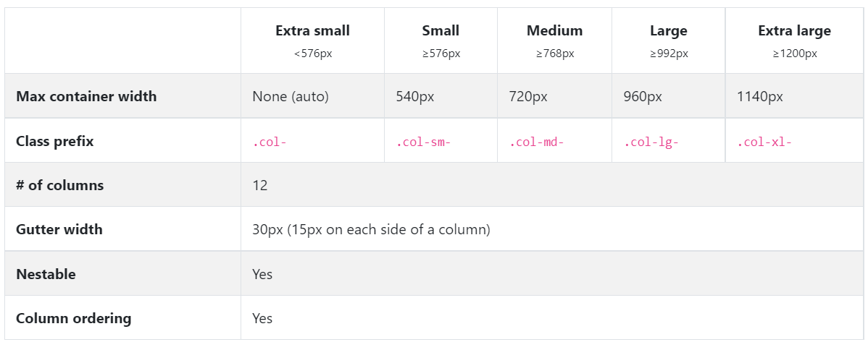
Grid System
In Bootstrap, the grid system presents a swift and simple way to build responsive website layouts.
Notes:
Replaced grid table
Explain about grid systems- self explanatory

Slide 30
Advantages of Grid Systems
The advantages of using grid systems in Bootstrap are:
It has a responsive design
It provides consistency
Flexibility
Easy to use
Cross-browser compatibility
Notes:
Self-explanatory

Slide 31
Advantages of Grid Systems
The advantages of using grid systems in Bootstrap are:
Group columns horizontally using rows
Create grid columns by specifying the number of available columns you wish to span. For example, three equal columns would use three .col-xs-4
Place the content within columns, and only columns may be immediate children of rows
Notes:
Self-explanatory

Slide 32
Bootstrap Grid Classes
The Bootstrap grid system has four classes:
xs (for phones)
sm (for tablets)
md (for desktops)
lg (for larger desktops)
These classes can be combined to create more dynamic and flexible layouts.
Notes:
xs (for phones - screens less than 768px wide)
sm (for tablets - screens equal to or greater than 768px wide)
md (for small laptops - screens equal to or greater than 992px wide)
lg (for laptops and desktops - screens equal to or greater than 1200px wide)

Slide 33
Bootstrap: Themes

Slide 34

Themes
Bootstrap themes are pre-built templates of HTML, CSS, and JavaScript that provide styling to design web page layouts.
Advantages
It saves time and money while building websites as they are ready-made packages.
It modifies the look and feel of Bootstrap components.
It adds new layouts and components for improving the appearance of web pages.
It integrates easily with content management system.
Notes:
Bootstrap themes are HTML, CSS, and JavaScript code packages that include styling, UI components, and page layouts for use in a web project. In essence, they are pre-built website templates that you can customize and expand upon. They are built on top of Bootstrap and extend its functionality.

Slide 35
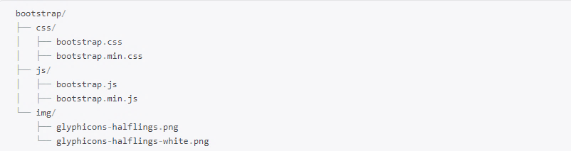
Bootstrap: File Structure
Bootstrap package consists of HTML, CSS, and JavaScript.
Notes:
Bootstrap consists of three main files: Bootstrap. css, Bootstrap. js, and Glyphicons, which includes a syntax collection. Keep in mind that Bootstrap's JS plugins and components necessitate the use of the jQuery library.

Slide 36
Installing Bootstrap with NPM Packages
Install Bootstrap with the npm packages using the command:
npm install bootstrap
Notes:
Self explanatory

Slide 37
Installing Bootstrap with NPM Packages
Add the following code to load the Bootstrap jQuery plugins:
require(‘bootstrap’)
Notes:
Self explanatory

Slide 38


Installing Bootstrap with NPM Packages
Bootstrap’s package.json contains additional data under the following key elements:
Sass
It is the path to Bootstrap’s main Sass source file.
Style
It is the path to Bootstrap’s non-minified CSS that is precompiled using the default settings.
Notes:
Explain about the Sass and Style elements

Slide 39
Installing Bootstrap with Other Packages
Install Bootstrap with the yarn packages using the command:
Example:
yarn install bootstrap
Notes:
Self explanatory

Slide 40
Installing Bootstrap with Other Packages
Install Bootstrap in Ruby apps using bundler and RubyGems by adding the following code in Gemfile:
Example:
gem ‘bootstrap’,’~> 4.3.1’
Notes:
Self explanatory

Slide 41
Installing Bootstrap with Other Packages
If bundler is not used, gem can be installed by running the following command:
Example:
gem install bootstrap –v 4.3.1
Notes:
Self explanatory

Slide 42
Installing Bootstrap with Other Packages
Install Bootstrap using NuGet in .NET by running the following command:
Example:
Install-Package bootstrap
Notes:
Self explanatory

Slide 43
Bootstrap: Maps
Sass maps are the key-value pairs that make it easier to generate CSS related files. It includes the !default flag which can be overridden and extended.
Notes:
The map file's main purpose is to connect the css source code to the less source code in the chrome dev tool.

Slide 44
Bootstrap: Maps
SASS maps are helpful when there are numerous values that are utilized frequently.
A user can declare a value once in a map and use it across your stylesheet, eliminating the need for them to write it out numerous times.
Notes:
All variables in the map are defined as standalone variables.
Add new colors to map, by creating a new Sass map with your custom values and merging it with the original map.
To remove colors from map, use map-remove.

Slide 45
Bootstrap: Maps
An example to modify a map:
$theme-colors: (
“primary”: #0074d9,
“danger”: #ff4136
);
Notes:
Self explanatory

Slide 46
Bootstrap: Maps
An example to add a map:
$theme-colors: (
“custom-color”: #900
);
Notes:
Self explanatory

Slide 47
Bootstrap: Maps
An example to remove from a map:
$theme-colors:map-remove(
$theme-colors,
“success”,”info”,”danger”);
Notes:
Self explanatory

Slide 48
Bootstrap: SASS Options
Bootstrap allows to customize the built-in variables for key global options in _variables.scss file.
Variable | Description
$spacer | It enables the default spacer value to programmatically generated spacer utilities.
$enable-rounded | It enables predefined border-radius styles on various components.
$enable-shadows | It enables predefined box-shadow styles on various components.
$enable-gradients | It enables predefined gradients via background-image styles on various components.
Source:https://getbootstrap.com/docs/4.0/getting-started/theming/
Notes:
Self explanatory

Slide 49
Bootstrap: SASS Options
Bootstrap allows to customize the built-in variables for key global options in _variables.scss file.
Variable | Description
$enable-transitions | It enables predefined transitions on various components.
$enable-grid-classes | It enables the generation of CSS classes for the grid system (Example: .container, .row, .col-md-1).
$enable-caret | It enables pseudo element caret on .dropdown-toggle.
$enable-print-styles | It enables styles for optimizing printing.
Source:https://getbootstrap.com/docs/4.0/getting-started/theming/
Notes:
Self explanatory

Slide 50
Bootstrap: Alerts

Slide 51
Bootstrap: Alert Class
A user in Bootstrap can easily create predefined alert messages using the alert class, followed by one of the below contextual classes:
.alert-success
.alert-info
.alert-danger
.alert-warning
Notes:
.alert-success: Green alert. Indicates a successful or positive action
.alert-danger: Red alert. Indicates a dangerous or potentially negative action
.alert-infoLight-: blue alert. Indicates a neutral informative change or action
.alert-warning: Yellow alert. Indicates caution should be taken with this action

Slide 52
Bootstrap Alerts: Example
Example:
<div class=“container”>
<h1>Bootstrap Alerts</h1>
<div class=“alert alert-success”>
<strong>Success!</strong> Indicates a successful or positive action.
</div>
<div class=“alert alert-info”>
<strong>Info!</strong> Indicates a neutral informative change or action.
</div>
<div class=“alert alert-warning”>
<strong>Warning!</strong> Indicates a warning that might need attention.
</div>
<div class=“alert alert-danger”>
<strong>Danger!</strong> Indicates a dangerous or potentially negative action.
</div>
</div>
Notes:
Self explanatory

Slide 53
Bootstrap Alerts: Example
The different Bootstrap alerts are:
Success!
It indicates a successful or positive action.
Info!
It indicates a neutral informative change or action.
Warning!
It indicates a warning that might need attention.
Danger!
It indicates a dangerous or potentially negative action.
Notes:
Self explanatory

Slide 54
Bootstrap: Additional Content
Alerts can have additional HTML elements.
Example:
<div class="alert alert-success" role="alert">
<h4 class="alert-heading">Well done!</h4>
<p>You have read the message.</p>
<hr>
<p class="mb-0">Use margin utilities whenever you want!</p>
</div>
Notes:
Self explanatory

Slide 55
Bootstrap: Alerts
Alerts can be dismissed in the following ways:
Example using JavaScript:
Example using data attributes of button:
$('.alert').alert()
<button type="button" class="close" data-dismiss="alert">
</button>
Notes:
Bootstrap 4 makes it simple to create predefined alert messages. With a small number of available and flexible alert messages, it provides contextual feedback messages for common user actions. Alerts for any length of text are available, as is an optional dismiss button.

Slide 56
JavaScript Behavior: Methods
The methods responsible in DOM manipulation are listed:
Method | Description
$().alert() | It makes an alert listen for click events on descendant elements, which have the data-dismiss=alert attribute.
$().alert('close') | It closes an alert by removing it from the DOM. If the .fade and .show classes are present on the element, the alert will fade out before it is removed.
$().alert('dispose') | It destroys an element’s alert.
Source:https://getbootstrap.com/docs/4.0/components/alerts/#methods
Notes:
Self explanatory

Slide 57
JavaScript Behavior: Methods
The methods responsible in DOM manipulation are listed:
Method | Description
$getInstance(alert) | It is a static method that returns the alert instance associated with a DOM element to the user.
getOrCreateInstance(element) | It is a static method that either returns an alert instance associated with a DOM element or creates a new one if the existing one was not initialized.
Source:https://getbootstrap.com/docs/4.0/components/alerts/#methods
Notes:
Self explanatory

Slide 58
JavaScript Behavior: Events
The events responsible in DOM manipulation are listed:
Event | Description
close.bs.alert | This event fires immediately when the close instance method is called.
closed.bs.alert | This event is fired when the alert has been closed (It will wait for CSS transitions to complete).
Source:https://getbootstrap.com/docs/4.0/components/alerts/#events
Notes:
Explain the methods responsible in DOM manipulation: Self explanatory

Slide 59
Implement Alerts
Duration: 20 Min.
Problem Statement:
You are given a project to demonstrate the implementation of link colors, utilization of HTML elements, and manipulation of DOM using methods and events.

Slide 60
Assisted Practice: Guidelines
Steps to be followed:
Implementation of link colors
Utilization of HTML elements
Manipulation of DOM using methods and events

Slide 61
Bootstrap: Cards, Tables, and Lists

Slide 62
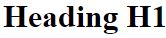
Typography
Typography is a Bootstrap feature for formatting and styling text content. Headings are set by HTML tags from <H1> to <H6> and some others such as <mark>, <small>, and <strong>.
HTML code | Display
<p class=“h1”>Heading H1</p>
<p class=“h2”>Heading H2</p>
<p class=“h3”>Heading H3</p>
<p class=“h4”>Heading H4</p>
<p class=“h5”>Heading H5</p>
<p class=“h6”>Heading H6</p>
Notes:
When you want to match the font styling of a heading but cannot use the associated HTML element, you can use the .h1 through .h6 classes.

Slide 63



Images
Image classes in Bootstrap are responsive so that they scale in size according to the size of their parent elements without losing the aspect ratio.
HTML code | Display
<img src="flower.jpg" class="img-rounded">
<img src="flower.jpg" class="img-circle">
<img src="flower.jpg" class="img-thumbnail">
Notes:
With.img-fluid, images in Bootstrap are made responsive. The image has max-width: 100%; and height: auto; applied to it so that it scales with the parent element.

Slide 64
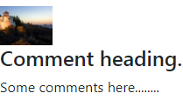
Media Objects
Media Objects are components to display images or videos that are aligned to the left or right of the content.
Output:
Example:
<div class="media-object">
<div class="media-object-section">
<div class="thumbnail">
<img src=“img.jpg" style="width:60px;">
</div>
</div>
<div class="media-object-section">
<h4>Comment heading.</h4>
<p>Some comments here........</p>
</div>
</div>
Notes:
The media object aids in the construction of complex and repetitive components in which some media is placed alongside content that does not wrap around said media. Furthermore, thanks to flexbox, it accomplishes this with only two required classes.

Slide 65
Cards
A card is a versatile and adaptable content container. It has header and footer options, contextual background colors, and display options.
Example
Output:
<div class="card">
<div class="card-body">This is a basic card</div>
</div>
This is a basic card
Notes:
Cards are built with as little markup and styling as possible while still providing a great deal of control and customization.

Slide 66
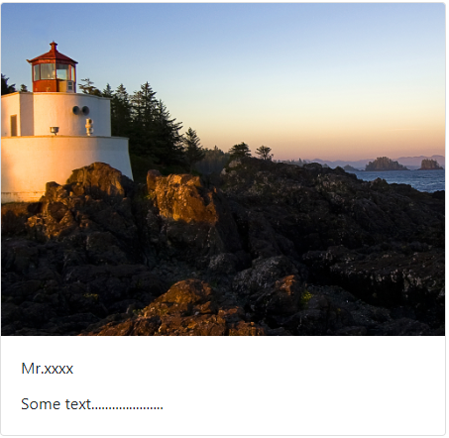
Cards
An example of an image card:
Output:
<div class="card" style="width:450px">
<img class="card-img-top" src="img.jpg">
<div class="card-body">
<p class="card-title">Mr.xxxx</p>
<p class="card-text">Some text...</p>
</div>
</div>
Notes:
They are built with flexbox and mix well with other Bootstrap components. They have no default margin, so use spacing utilities as needed.

Slide 67
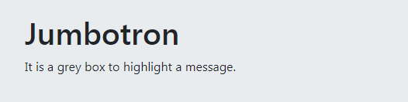
Jumbotrons
A Jumbotron is a component to display a message in a grey box to call for extra attention to the text.
Example:
<div class="jumbotron">
<h1>Jumbotron</h1>
<p>It is a grey box to highlight a message.</p>
</div>
Output:
Notes:
A jumbotron is a lightweight, adaptable component that can optionally extend the entire viewport to highlight important marketing messages on your website.

Slide 68
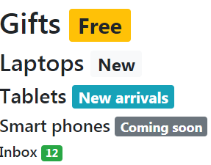
Badges
Badges or labels are used to highlight or show additional information related to a particular content.
Example:
<h1>Gifts <span class="badge badge-warning">Free</span></h1>
<h2>Laptops <span class="badge badge-light">New</span></h2>
<h3>Tablets <span class="badge badge-info">New arrivals</span></h3>
<h4>Smart phones <span class="badge badge-secondary">Coming soon</span></h4>
<h5>Inbox <span class="badge badge-success">12</span></h5>
Output:
Notes:
By using relative font sizing and em units, badges scale to match the size of the immediate parent element.

Slide 69
Glyphicons
Glyphicons are icon fonts that can be used on web pages in the form of text, toolbars, forms, buttons, and navigation toolbars.
HTML Code | Display
<span class = "glyphicon glyphicon-home"></span>
<span class = "glyphicon glyphicon-ok"></span>
<span class = "glyphicon glyphicon-comment"></span>
<span class = "glyphicon glyphicon-thumbs-up"></span>
<span class = "glyphicon glyphicon-fullscreen"></span>
<span class = "glyphicon glyphicon-volume-up"></span>
<span class = "glyphicon glyphicon-search"></span>
Notes:
By using relative font sizing and em units, badges scale to match the size of the immediate parent element.

Slide 70
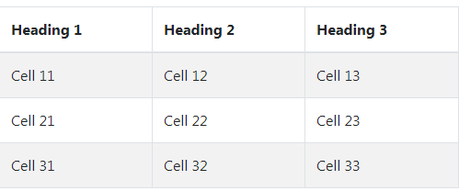
Tables
Tables allow data such as text, images, or links to be arranged into rows and columns.
Example:
<table class="table table-striped table-bordered">
<thead>
<tr>
<th>Heading 1</th> <th>Heading 2</th>
<th>Heading 3</th>
</tr>
</thead>
<tbody>
<tr>
<td>Cell 11</td> <td>Cell 12</td> <td>Cell 13</td>
</tr>
<tr>
<td>Cell 21</td> <td>Cell 22</td> <td>Cell 23</td>
</tr>
<tr>
<td>Cell 31</td> <td>Cell 32</td> <td>Cell 33</td>
</tr>
</tbody>
</table>
Output:
Notes:
Bootstarp has designed tables to be opt-in due to the widespread use of tables in third-party widgets such as calendars and date pickers.
Simply add the base class .table to any <table> and then extend with custom styles or the included modifier classes.

Slide 71
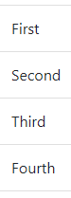
List Groups
List groups are a versatile and effective component for displaying a collection of items.
Example of unordered list:
Output:
<ul class="list-group">
<li class="list-group-item">First</li>
<li class="list-group-item">Second</li>
<li class="list-group-item">Third</li>
<li class="list-group-item">Fourth</li>
</ul>
Notes:
List groups are a versatile and effective component for displaying a series of items. Modify and extend them to support almost any content.

Slide 72
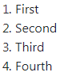
List Groups
An example of an ordered list:
Output:
<ol>
<li>First</li>
<li>Second</li>
<li>Third</li>
<li>Fourth</li>
</ol>
Notes:
An ordered list adds numbers to list items

Slide 73
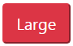
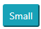
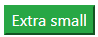
Buttons
A button is used to trigger an action. The optional style and color classes can be used to change the appearance of a web page.
Output:
Example:
<button class="btn-lg btn-danger">Large</button>
<button class="btn-sm btn-info">Small</button>
<button class="btn-xs btn-success">Extra small</button>
<button class="btn-block btn-primary">Block</button>
Notes:
Bootstrap includes several predefined button styles, each with its own semantic purpose, as well as a few extras for added control.

Slide 74
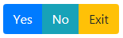
Button Groups
A button group is a series of multiple buttons in a line.
Example:
<div class="btn-group" role="group">
<button type="button" class="btn btn-primary">Yes</button>
<button type="button" class="btn btn-info">No</button>
<button type="button" class="btn btn-warning">Exit</button>
</div>
Output:
Notes:
With the button group, group a series of buttons on a single line and supercharge them with JavaScript.

Slide 75
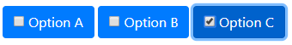
Stateful Buttons
Stateful buttons can be used to toggle between states. These buttons can change text and color when clicked or hovered over.
Example:
Output:
<label class="btn btn-primary active">
<input type="checkbox" name="options“> Option A
</label>
<label class="btn btn-primary">
<input type="checkbox" name="options“> Option B
</label>
<label class="btn btn-primary active">
<input type="checkbox" name="options“> Option C
</label>
Notes:
Stateful buttons can be used to toggle between states. These buttons can change text and color when clicked or hovered over.

Slide 76
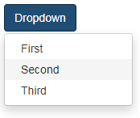
Dropdowns
A dropdown is a menu that displays a list of text or links from which a user can choose.
Example:
Output:
<button type="button" data-toggle="dropdown">Dropdown</button>
<ul class="dropdown-menu">
<li><a href="#">First</a></li>
<li><a href="#">Second</a></li>
<li><a href="#">Third</a></li>
</ul>
Notes:
Dropdowns are toggleable contextual overlays that display lists of links and other information. The included Bootstrap dropdown JavaScript plugin makes them interactive.

Slide 77
Header and Footer
Bootstrap header is a method used to hold elements. It is usually placed above the body element.
Example:
<div class="card-header bg-transparent border-success">Bootstrap</div>
Notes:
Headers are compositions that extend the functionality of the standard navbar. They include extra components such as a jumbotron, sub-navbars, or image covers that serve as containers for additional navigation elements.

Slide 78
Header and Footer
Bootstrap footer is a navigation method used to hold links, buttons, and other elements. It is usually placed at the end of a web page.
Example:
<div class="card-footer bg-transparent border-success">Updated 3 minutes ago</div>
Notes:
Footer is an additional navigation method for websites in Bootstrap. It can contain links, buttons, company information, copyrights, forms, and a variety of other elements.

Slide 79
Header and Footer
Output:
Example:
<div class="card border-success mb-3" style="max-width: 18rem;">
<div class="card-header bg-transparent border- success">Bootstrap</div>
<div class="card-body text-success">
<h5 class="card-title">Header and Footer</h5>
<p class="card-text">This is the simplest way of using header and footer</p>
</div>
<div class="card-footer bg-transparent border-success">Updated 3 minutes ago</div>
</div>
Bootstrap
Header and Footer
This is the simplest way of using a header and footer
Updated 3 minutes ago
Notes:
Self explanatory

Slide 80
Text Alignments: Text-Left
Bootstrap allows to align text to the left side of an HTML page.
Output:
Example:
<div class="card" style="width: 18rem;">
<div class="card-body">
<h5 class="card-title">Rock Music</h5>
<p class="card-text">A popular genre of music.</p>
<a href="#" class="btn btn-primary">Buy</a>
</div>
</div>
Rock Music
A popular genre of music.
Buy
Notes:
There are responsive classes for left, right, and center alignment that use the same viewport width breakpoints as the grid system.

Slide 81
Text Alignments: Text-Center
Bootstrap allows to align the text to the center of an HTML page.
Output:
Example:
<div class="card text-center" style="width: 18rem;">
<div class="card-body">
<h5 class="card-title">Rock Music</h5>
<p class="card-text">A popular genre of music.</p>
<a href="#" class="btn btn-primary">Buy</a>
</div>
</div>
Rock Music
A popular genre of music.
Buy
Notes:
Bootstrap allows to align the text to the center of an HTML page.

Slide 82
Text Alignments: Text-Right
Bootstrap allows to align the text to the right side of an HTML page.
Output:
Example:
<div class="card text-right" style="width: 18rem;">
<div class="card-body">
<h5 class="card-title">Rock Music</h5>
<p class="card-text">A popular genre of music.</p>
<a href="#" class="btn btn-primary">Buy</a>
</div>
</div>
Rock Music
A popular genre of music.
Buy
Notes:
Bootstrap allows to align the text to the right side of an HTML page.

Slide 83
Wells
The .well class adds a rounded border with a gray background color and padding around an element.
Example:
<div class="well">Well example</div>
Output:
Well example
Notes:
Add the.well-sm class for small wells or.well-lg class for large wells to change the size of the well.

Slide 84
Helper Classes
Helper classes are rules that can be reused by using class selectors. They allow the user to apply a style to an element without creating a custom rule for that element.
Notes:
Text-colors are used with helper classes that add meaning to text.

Slide 85
Helper Classes
The different Helper classes used in Bootstrap are:
Carets
1
Screen reader content
Quick floats
6
2
5
3
Showing and hiding content
Center content blocks
4
Clearfix
Notes:
List the different helper classes

Slide 86
Helper Classes
The different Helper classes used in Bootstrap are:
Carets
It helps in indicating drop-down functionality and navigation. The class caret with a <span> element can be used to implement this functionality.
Example:
<p>Caret Example<span class = "caret"></span></p>
Notes:
Self explanatory

Slide 87
Helper Classes
The different Helper classes used in Bootstrap are:
Quick floats
The classes pull-left and pull-right can be used to float an element to the left or right.
Example:
<div class = "pull-left">Quick Float to left</div>
<div class = "pull-right">Quick Float to right</div>
Notes:
Self explanatory

Slide 88
Helper Classes
The different Helper classes used in Bootstrap are:
Center content blocks
The center-block class can be used to position an element in the center.
Example:
<div class = "row">
<div class = "center-block" style = "width:200px; background-color:#ccc;">
This is an example for center-block
</div>
</div>
Notes:
Self explanatory

Slide 89
Helper Classes
The different Helper classes used in Bootstrap are:
Clearfix
The .clearfix class can be used to clear the float of any element.
Example:
<div class = "clearfix" style = "background: #D8D8D8;border: 1px solid #000; padding: 10px;">
<div class = "pull-left" style = "background:#58D3F7;">
Quick Float to left
</div>
<div class = "pull-right" style = "background: #DA81F5;">
Quick Float to right
</div>
</div>
Notes:
Self explanatory

Slide 90
Helper Classes
The different Helper classes used in Bootstrap are:
Showing and hiding content
The.show and.hidden classes can be used to show or hide an element (including for screen readers).
Example:
<div class = "row" style = "padding: 91px 100px 19px 50px;">
<div class = "show" style = "left-margin:10px; width:300px; background-color:#ccc;">
This is an example for show class
</div>
<div class = "hidden" style = "width:200px; background-color:#ccc;">
This is an example for hide class
</div>
</div>
Notes:
Self explanatory

Slide 91
Helper Classes
The different Helper classes used in Bootstrap are:
Screen reader content
The.sr-only class allows a user to hide an element from all devices except screen readers.
Example:
<div class = "row">
<div class = "center-block" style = "width:200px; background-color:#ccc;">
This is an example for center-block
</div>
</div>
Notes:
Self explanatory

Slide 92
Develop a Static Web Page
Duration: 50 min
Problem Statement:
You are given a project to develop a static web page.

Slide 93
Assisted Practice: Guidelines
Steps to be followed:
Build a static web page in your code editor.
View the results in your local browser.

Slide 94
Bootstrap: Accordion and Carousel

Slide 95
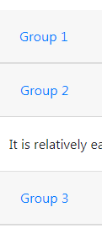
Accordion
An accordion is used in web pages to accommodate more content using collapsible items.
Example:
Output:
<div class="accordion">
<button class="btn btn-link" type="button">Group 1</button></div>
<div class="bordered">
<button class="btn btn-link collapsed" type="button">Group 2</button></div>
<div class="bordered">
It is relatively easy to learn, with the basics being accessible to most people.</div>
<div class="bordered">
<button class="btn btn-link collapsed" type="button">Group 3</button></div>
Notes:
The accordion is collapsible because it uses collapse internally. Add the.open class to the.accordion to render an expanded accordion.

Slide 96
Carousel
A carousel is a slideshow for cycling through a series of content, which may be images or text.
Example:
<div class="carousel-item active">
<img src="aa.jpg">
</div>
<div class="carousel-item">
<img src="bb.jpg">
</div>
<div class="carousel-item">
<img src="cc.jpg">
</div>
Notes:
The carousel is a slideshow that uses CSS 3D transforms and a bit of JavaScript to cycle through a series of content. It can be used with a sequence of images, text, or custom markup. It also includes previous/next controls and indicator support.

Slide 97
Adding Slides
A slider is similar to a carousel and is used to show a slideshow of a series of images or text.
Example:
<div class="slideshow-container">
<div>
<div>1 / 10</div>
<img src="img1.jpg" style="width:100%">
<div class="text">Caption 1</div>
</div>
<div>
<div>2 / 10</div>
<img src="img2.jpg" style="width:100%">
<div class="text">Caption 2</div>
</div>
Notes:
The Bootstrap slider is an interactive component that allows the user to quickly slide through potential values spread across a specified range.

Slide 98
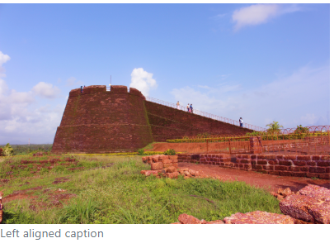
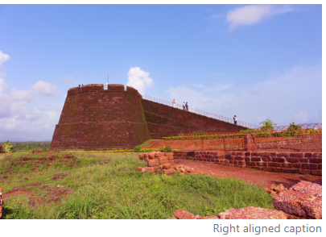
Adding Captions
Captions can be added to images using the figure class. They can be aligned to the left, center, or right.
Example:
Outputs:
<figure class="figure">
<img src=“pic.jpg" style="width: 400px">
<figcaption class="figure-caption text-left">Left aligned caption</figcaption>
</figure>
Example:
<figure class="figure">
<img src=“pic.jpg" style="width: 400px">
<figcaption class="figure-caption text-right“>Right aligned caption</figcaption>
</figure>
Notes:
Bootstrap figures are commonly used elements for displaying images with the caption. A caption can be left-aligned or right-align. Detailed documentation and more examples you can find in our Bootstrap Figures Docs.

Slide 99
Implement a Slideshow to a Static Web page
Duration: 30 min
Problem Statement:
You are given a project to implement a slideshow on a static webpage. Implementing a slideshow feature to a static webpage helps in user retention and increases the overall look-and-feel of the webpage.

Slide 100
Assisted Practice: Guidelines
Steps to be followed:
Build a slideshow that works from left-to-right and vice versa

Slide 101
Bootstrap: Forms and Form Validations

Slide 102
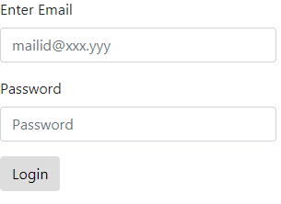
Forms
Forms are elements used to collect data from visitors to the website. They can be text boxes, buttons, checkboxes, radio buttons, login fields, and password fields.
Example:
Output:
<form action="#">
<div class="form-group">
<label>Enter Email</label>
<input type="email" class="form-control" placeholder="mailid@xxx.yyy">
</div>
<div class="form-group">
<label>Password</label>
<input type="password" class="form-control" placeholder="Password">
</div>
<button type="submit">Login</button>
</form>
Notes:
The.form-control class is used to style textual form controls such as input>s, select>s, and textarea>s. Styles for general appearance, focus state, sizing, and more are included.

Slide 103
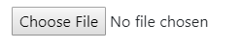
Form Controls
Form controls such as <select> and <input> are styled using the .form-control class.
Output:
Example:
<form>
<div class="form-group">
<label for="formcontrol">Choose a file to upload</label>
<input type="file" class="form- control-file" id="formcontrol">
</div>
</form>
Choose a file to upload
Notes:
With classes, Bootstrap form controls extend on Rebooted form styles. Use these classes to enable customized rendering across browsers and devices.

Slide 104
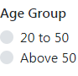
Custom Forms
Custom forms are HTML elements that replace default elements of a browser to allow customization and consistency across browsers.
Example:
<h6>Age Group</h6>
<div class="custom-control custom-radio">
<input type="radio“ class="custom-control-input">
<label class="custom-control-label”>20 to 50</label>
</div>
<div class="custom-control custom-radio">
<input type="radio“ class="custom-control-input">
<label class="custom-control-label“>Above 50</label>
</div>
Output:
Notes:
Custom forms are HTML elements that replace default elements of a browser to allow customization and consistency across browsers.

Slide 105
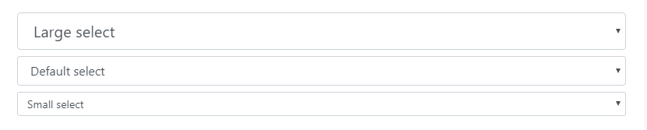
Form Controls: Sizing
Form control sizes can be set using .form-control-lg and .form-control-sm.
Output:
Example:
<select class="form-control form-control-lg">
<option>Large select</option>
</select>
<select class="form-control">
<option>Default select</option>
</select>
<select class="form-control form-control-sm">
<option>Small select</option>
</select>
Notes:
Form control sizes can be set using .form-control-lg and .form-control-sm.

Slide 106
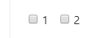
Form Controls: Inline
Checkboxes and radios can be placed horizontally by adding .form-check-inline to any .form-check.
Output:
Example:
<div class="form-check form-check-inline">
<input class="form-check-input" type="checkbox" id="inlineCheckbox1" value="option1">
<label class="form-check-label" for="inlineCheckbox1">1</label>
</div>
<div class="form-check form-check-inline">
<input class="form-check-input" type="checkbox" id="inlineCheckbox2" value="option2">
<label class="form-check-label" for="inlineCheckbox2">2</label>
</div>
Notes:
Checkboxes and radios can be placed horizontally by adding .form-check-inline to any .form-check.

Slide 107
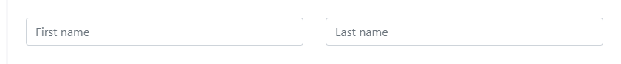
Form Controls: Grid
Form grids are used to build complex forms.
Using row:
Output:
Example:
<form>
<div class="row">
<div class="col">
<input type="text" class="form-control" placeholder="First name">
</div>
<div class="col">
<input type="text" class="form-control" placeholder="Last name">
</div>
</div>
</form>
Notes:
Form grids are used to build complex forms.

Slide 108
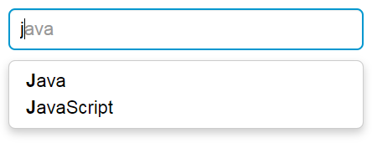
Typeaheads
Typeaheads are used to show hints to users while filling forms for auto-completing them. This saves time and reduces input mistakes.
Output:
Example:
<script type="text/javascript">
$(document).ready(function(){
var cars = ['HTML', 'HTML5', 'Java', 'JavaScript', 'CSS', 'DTD', 'Bootstrap'];
</script>
Display:
Notes:
The primary goal of typeahead is to improve the user experience by providing hints or a list of possible choices based on the text entered while filling out a form.

Slide 109
Disabling Forms
Forms can be disabled from user interactions using the disabled boolean attribute. It can be used to a <fieldset> to disable form controls.
Example:
<form>
<fieldset disabled>
<div class="form-group">
<label for="disabledSelect">Disabled select menu</label>
<select id="disabledSelect" class="form-control">
<option>Disabled select</option>
</select>
</div>
<button type="submit" class="btn btn-primary">Submit</button>
</fieldset>
</form>
Notes:
Forms can be disabled from user interactions using the disabled boolean attribute. It can be used to a <fieldset> to disable form controls.

Slide 110

Forms Validation
Forms validation is a method by which the server checks if a user has entered all the necessary data in the required format.
Notes:
Forms validation is a method by which the server checks if a user has entered all the necessary data in the required format.

Slide 111
Forms Validation
The functions of form validation are:
Basic validation
A form is checked for any missing data in mandatory fields.
Data form validation
A form is checked for data accuracy.
Notes:
A form is checked for any missing data in mandatory fields.
A form is checked for data accuracy.

Slide 112
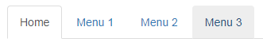
Tabs
Tabs are components in which content or links are placed in separate panes to open different pages and sections.
Example:
Output:
<ul class="nav nav-tabs">
<li class="active"><a href="#">Home</a></li>
<li><a href="#">Menu 1</a></li>
<li><a href="#">Menu 2</a></li>
<li><a href="#">Menu 3</a></li>
</ul>
Notes:
Tabs are components in which content or links are placed in separate panes to open different pages and sections.

Slide 113
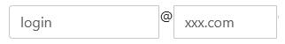
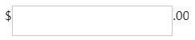
Input Group
Input groups are extended form controls which are used to add text or buttons before or after text-based inputs.
Example:
Outputs:
<div class = "input-group">
<input type = "text" class = "form-control" placeholder = "login">
<span class = "input-group-addon">@</span>
<input type = "text" class = "form-control" placeholder = "xxx.com">
</div>
Example:
<div class = "input-group">
<span class = "input-group-addon">$</span>
<input type = "text" class =" form-control">
<span class = "input-group-addon">.00</span>
</div>
Notes:
input groups Add text, buttons, or button groups on either side of textual inputs, custom selects, and custom file inputs to easily extend form controls.

Slide 114
Forms
Duration: 30 Min.
Problem Statement:
You are given a project to create a form using Bootstrap.

Slide 115
Assisted Practice: Guidelines
Steps to be followed:
Build a form using Bootstrap in your code editor
View results in your local browser

Slide 116
Bootstrap: Modal Components

Slide 117
Modals
Modals are pop-up windows that display notifications or alerts because of actions like a mouse hover or a click.
Example:
<button class="trigger">Show the modal</button>
<div class="modal">
<div class="modal-content">
<span class="close-button">×</span>
<h1>Modal window opened</h1>
</div>
</div>
Notes:
To add dialogs to your site for lightboxes, user notifications, or completely custom content, use Bootstrap's JavaScript modal plugin.

Slide 118

Modals: Points to Remember
Bigger modals can be isolated from a web page for better view.
Modals can be aligned vertically at center using .modal-dialog-centered to .modal-dialog.
Bootstrap's grid can be used in a modal by nesting .container-fluid.
A modal can be called in JavaScript with the $('#myModal').modal(options) code.
Notes:
Self explanatory

Slide 119

Tooltips
A tooltip is a pop-up to display a message when users hover or click on objects such as an images, buttons, links, or tags.
Notes:
A tooltip is a pop-up to display a message when users hover or click on objects such as an images, buttons, links, or tags.

Slide 120
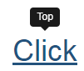
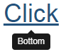
Tooltips
The tooltip can be placed at different locations, such as:
Example:
Output:
<a href="#" data-toggle="tooltip" data-placement="top" title="Top">Click</a>
Example:
<a href="#" data-toggle="tooltip" data-placement="bottom" title="Bottom">Click</a>
Notes:
Documentation and examples for adding custom Bootstrap tooltips with CSS and JavaScript using CSS3 for animations and data-attributes for local title storage are provided in tooltips.

Slide 121
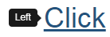

Tooltips
The tooltip can be placed at different locations, such as:
Example:
Output:
<a href="#" data-toggle="tooltip" data-placement="left" title="Left">Click</a>
Example:
<a href="#" data-toggle="tooltip" data-placement="right" title="Right">Click</a>
Notes:
Documentation and examples for adding custom Bootstrap tooltips with CSS and JavaScript using CSS3 for animations and data-attributes for local title storage are provided in tooltips.

Slide 122
Implement a Modal to a Static Web Page
Duration: 30 Min.
Problem Statement:
You are given a project to implement a modal that can be used to display terms and conditions. Modals can share a large amount of information.

Slide 123
Assisted Practice: Guidelines
Steps to be followed:
Build a modal that is responsive
Include all entities or elements that you have learned

Slide 124
Bootstrap: Nav and Navbar

Slide 125
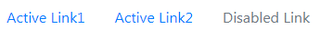
Nav
The nav tag is used to define a block of links for navigation, for the current page, or for other pages.
Output:
Example:
<ul class="nav">
<li class="nav-item">
<a class="nav-link active" href="#">Active Link1</a>
</li>
<li class="nav-item">
<a class="nav-link" href="#">Active Link2</a>
</li>
<li class="nav-item">
<a class="nav-link disabled" href="#">Disabled Link</a>
</li>
</ul>
Notes:
Navbar navigation links are built on our.nav options and require the use of toggler classes for proper responsive styling. To keep your navbar contents securely aligned, navigation in navbars will also grow to occupy as much horizontal space as possible.

Slide 126

Navigation Bar
A navigation bar is a set of buttons or links used to connect to different sections of the website. Each link can have different features like dropdowns and variation in sizes, colors, and fonts.
Notes:
A navigation bar is a set of buttons or links used to connect to different sections of the website. Each link can have different features like dropdowns and variation in sizes, colors, and fonts.

Slide 127
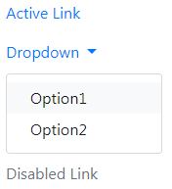
Navigation Bar
An example of navigation bar:
Output:
<nav class="navbar">
<ul class="navbar-nav">
<li class="nav-item active">
<a class="nav-link" href="#">Active Link</a>
</li>
<li class="nav-item dropdown">
<a class="nav-link dropdown-toggle" href="#" data-toggle="dropdown">
Dropdown
</a>
<div class="dropdown-menu" aria-labelledby="navbarDropdown">
<a class="dropdown-item" href="#">Option1</a>
<a class="dropdown-item" href="#">Option2</a>
</li>
<li class="nav-item">
<a class="nav-link disabled" href="#">Disabled Link</a>
</li>
</ul>
</nav>
Notes:
Self explanatory

Slide 128
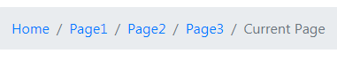
Breadcrumbs
A breadcrumb is a scheme for navigation that shows the full path to the current page on the website.
Example:
Output:
<ul class="breadcrumb">
<li class="breadcrumb-item"><a href="#">Home</a></li>
<li class="breadcrumb-item"><a href="#">Page1</a></li>
<li class="breadcrumb-item"><a href="#">Page2</a></li>
<li class="breadcrumb-item"><a href="#">Page3</a></li>
<li class="breadcrumb-item active" aria-current="page">Current Page</li>
</ul>
Notes:
A breadcrumb is a scheme for navigation that shows the full path to the current page on the website.

Slide 129
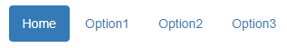
Pills
Pills are like tabs, where the links are placed to navigate to different sections of the website.
Output:
Example:
<ul class="nav nav-pills">
<li class="active"><a href="#">Home</a></li>
<li><a href="#">Option1</a></li>
<li><a href="#">Option2</a></li>
<li><a href="#">Option3</a></li>
</ul>
Notes:
Pills are like tabs, where the links are placed to navigate to different sections of the website.

Slide 130
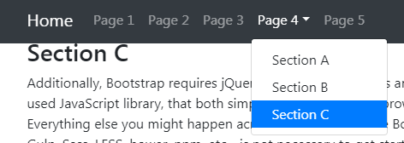
Scrollspy
A scrollspy is a navigation scheme that highlights the navigation links based on the scroll position to show where the user is currently in the page.
Example:
<body data-spy="scroll">
<a href="#">Home</a>
<ul>
<li class="nav-item"><a href="#">Page 1</a></li>
<li class="nav-item"><a href="#">Page 2</a></li>
<li class="nav-item"><a href="#">Page 3</a></li>
<li class="nav-item dropdown">
<a href="#" class="nav-link dropdown-toggle">Page 4</a>
<div class="dropdown-menu">
<a href="#" class="dropdown-item">Section A</a>
<a href="#" class="dropdown-item">Section B</a>
<a href="#" class="dropdown-item">Section C</a>
</div>
</li>
<li class="nav-item"><a href="#">Page 5</a>
Output:
Notes:
A scrollspy is a navigation scheme that highlights the navigation links based on the scroll position to show where the user is currently in the page.

Slide 131
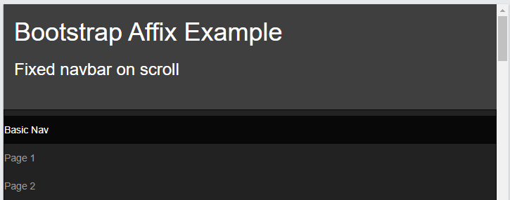
Affix
The Affix plugin enables an element to be locked to a specific area of the page. It is used with navigation menus to keep them in place while scrolling up and down the page.
Example:
.affix {
top: 0;
width: 100%;
z-index: 9999 !important;
}
.affix + .container-fluid {
padding-top: 70px;
}
Notes:
The Affix plugin enables an element to be locked to a specific area of the page. It is used with navigation menus to keep them in place while scrolling up and down the page.

Slide 132
Implement Navbars to a Static Web Page
Duration: 30 Min.
Problem Statement:
You are given a project to implement a navbar that can be used to navigate throughout a web page. Navbars can navigate directly to a marked area on a web page.

Slide 133
Assisted Practice: Guidelines
Steps to be followed:
Build a responsive static page
Add all the entities or elements you have learned
Include a minimum of three entities or elements

Slide 134
Bootstrap: Pagination and Progress

Slide 135
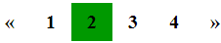
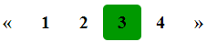
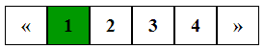
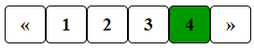
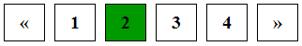
Pagination
Pagination is used to divide a document into different pages with numbers.
Simple pagination
Active and hoverable pagination
Rounded active and hoverable pagination
Bordered pagination
Rounded border pagination
Space between pagination
Notes:
Pagination links can be customized for specific situations. For links that appear unclickable, use.disabled, and for the current page, use.active.

Slide 136
Progress Bars
Progress bars are colored stripes that display the amount of progress a user has made in a process.
Example:
<div class="progress">
<div class="progress-bar" style="width:50%">
</div>
</div>
Output:
Notes:
Progress bars are colored stripes that display the amount of progress a user has made in a process.

Slide 137
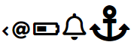
Icons
Icons are images grouped in libraries. Options are provided for better usability and scalability.
Example:
Output:
<i class="fas fa-angle-left" style="font-size:20px"></i>
<i class="fas fa-at" style="font-size:24px"></i>
<i class="fas fa-battery-half" style="font-size:28px"></i>
<i class="far fa-bell" style="font-size:36px"></i>
<i class="fas fa-anchor" style="font-size:48px"></i>
Notes:
Icons are images grouped in libraries. Options are provided for better usability and scalability.

Slide 138

Spinners
A spinner is a component in HTML and CSS which shows the loading state of the page.
Example:
Output:
<div class="spinner-border text-primary">
<span class="sr-only">Loading...</span>
</div>
<div class="spinner-border text-secondary">
<span class="sr-only">Loading...</span>
</div>
<div class="spinner-border text-warning">
<span class="sr-only">Loading...</span>
</div>
Notes:
A spinner is a component in HTML and CSS which shows the loading state of the page.

Slide 139
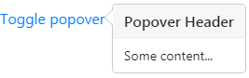
Popovers
Popovers are used to display additional information about elements when a user hovers over or clicks it. They contain more content than tooltips.
Example:
Display:
<div>
<a href="#" data-toggle="popover" title="Popover Header" data-content="Some content...">Toggle popover</a>
</div>
<script>
$(document).ready(function(){
$('[data-toggle="popover"]').popover();
});
</script>
Notes:
Popovers are used to display additional information about elements when a user hovers over or clicks it. They contain more content than tooltips.

Slide 140
Pager
Pager is another type of pagination. It has previous and next buttons.
Previous
Next
Notes:
Explain about pager

Slide 141
Pager
Add the .pager class to an <ul> element to create previous and next buttons.
Example:
<ul class="pager">
<li><a href="#">Previous</a></li>
<li><a href="#">Next</a></li>
</ul>
Notes:
Add the .pager class to an <ul> element to create previous and next buttons.

Slide 142
Navigation and Pagination
Duration: 45 Min.
Problem Statement:
You are given a project to add navigation using a navbar and use pagination to navigate in Bootstrap.

Slide 143
Assisted Practice: Guidelines
Steps to be followed:
Build a navbar using Bootstrap in your code editor.
View results in the browser.
Add pagination to your website using Bootstrap.
View results in the browser.

Slide 144
Responsive web design is a responsive browser that can adapt to different screen sizes.
Bootstrap helps to create responsive and mobile-friendly websites.
In Bootstrap, the grid system presents a swift and simple way to build responsive website layouts.
Bootstrap themes are pre-built templates of HTML, CSS, and JavaScript that provide styling to design web page layouts.

Slide 146
Which of the following is not a feature of Bootstrap?
1
It is easy to use.
It is compatible with all browsers.
It is a closed source framework.
It has a consistent design.
Notes:
This slide is self-explanatory.

Slide 147
Which of the following is not a feature of Bootstrap?
1
It is easy to use.
It is compatible with all browsers.
It is a closed source framework.
It has a consistent design.
C
Bootstrap is an open-source framework.
Notes:
This slide is self-explanatory.

Slide 148
Elements used to auto-complete user forms are called __________.
2
Auto text
Predictors
Typeaheads
Showhints
Notes:
This slide is self-explanatory.

Slide 149
Elements used to auto-complete user forms are called __________.
2
Auto text
Predictors
Typeaheads
Showhints
C
Typeaheads are used to auto-complete user forms.
Notes:
This slide is self-explanatory.

Slide 150
Class types used to include additional text after text-based inputs are called _________
3
Inputs
Input groups
Badges
Buttons
Notes:
This slide is self-explanatory.

Slide 151
Class types used to include additional text after text-based inputs are called _________
3
Inputs
Input groups
Badges
Buttons
B
Input groups are classes used to add additional text after text-based inputs.
Notes:
This slide is self-explanatory.

Slide 152
What is the purpose of using Scrollspy?
4
To show where a user is on a page
To scroll the page horizontally and vertically
To open a clicked link
To open a collapsible item
Notes:
This slide is self-explanatory.

Slide 153
What is the purpose of using Scrollspy?
4
To show where a user is on a page
To scroll the page horizontally and vertically
To open a clicked link
To open a collapsible item
A
Scrollspy highlights the link to the current page to show where the user is on a page.
Notes:
This slide is self-explanatory.

Slide 154
Which class shows the amount of progress?
5
Alert
Modal
Progress bar
Pagination
Notes:
This slide is self-explanatory.

Slide 155
Which class shows the amount of progress?
5
Alert
Modal
Progress bar
Pagination
C
Progress bar is the class used to show the amount of progress.
Notes:
This slide is self-explanatory.

Slide 156
Thank You

